Slide 1

LLM Tutorial

Slide 2

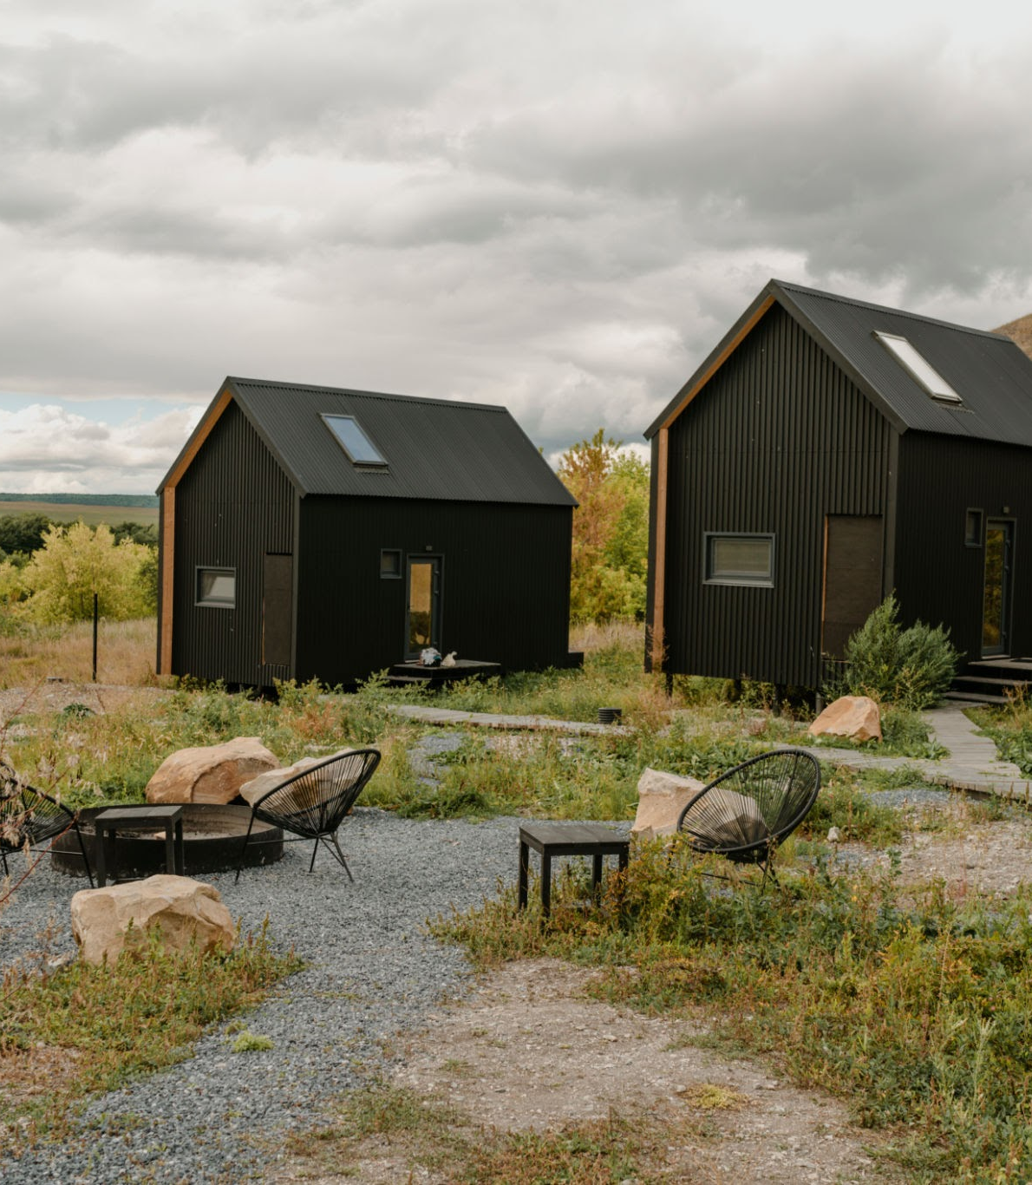
Background
Synopsis
This tutorial goes over using LLMs to classify a patient having allergies based on severity of a reaction. I used the latest Synthea Sample Data dataset as of April 2025. The LLMs will classify a patient as having or not having an allergy through different prompting methods.

Slide 3
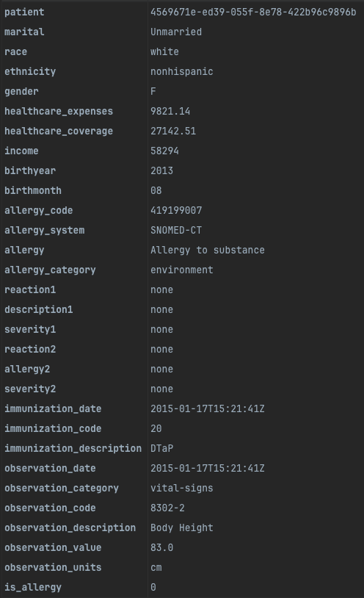
Patient entry to message
“The patient married status is : Unmarried.
He is 8 years old, is white and nonhispanic.
His income is $33,617. He had His DTaP (20) immunization on 2017-04-16T15:13:33Z He has Body Height (8302-2) on 2017-09-17T15:13:33Z with a value of 72.1 cm “
Disclaimers:
The examples above are not of the same person. This is just to show what aspects of a patient entry are converted to a message for the LLM
Patient information is synthetic (fully fabricated). No sensitive information is used

Slide 4
Methods
Zero-shot learning
One-shot learning
Multi-shot learning
Chain of thought learning
Results

Slide 5
Zero-shot prompt
One-shot prompt
“In a one word answer either 'True' or 'False' (no punctuation) and based on the following information, does the patient have an allergy?”
“You are a medical professional who specializes in diagnosing patients who have allergies based on a small description of their medical records\n. In a one word answer either 'True' or 'False' and based on the following information, does the patient have an allergy?”
“You are a medical professional who specializes in diagnosing patients who have allergies based on a small description of their medical records.
A patient such as: ```{allergy_patients.iloc[0]}``` and a patient such as: ```{allergy_patients.iloc[1]}``` are correctly diagnosed with an allergy. \nIn a one word answer either 'True' or 'False' and based on the following information, does the patient have an allergy?”
ON NEXT SLIDE
Multi-shot prompt
Chain-of-thought prompt

Slide 6
CHAIN-OF-THOUGHT
All prompts then append the patient message information.
Prompts 2 & 3 also include the response from the previous prompt response.
1)
"You are a medical professional who specializes in diagnosing patients who have allergies based on a small description of their medical records\n. A patient such as: ```{allergy_patients.iloc[0]}``` and a patient such as: ```{allergy_patients.iloc[1]}``` are correctly diagnosed with an allergy. You will be provided with information about a patient with the end goal of determining if they have an allergy. You will look at the data and then respond with your first thought about what the data is saying. You are not making the final decision. You will give your initial thoughts that will be given to someone else to analyze the data alongside your thoughts."
2)
"You are a medical professional who specializes in diagnosing patients who have allergies based on a small description of their medical records\n. A patient such as: ```{allergy_patients.iloc[0]}``` and a patient such as: ```{allergy_patients.iloc[1]}``` are correctly diagnosed with an allergy. You will be provided with information about a patient with the end goal of determining if they have an allergy. You are given the patient data and you are also given a first thought from another source of what they believe the data is saying. You will look at the data and their thought and then respond with your first thought about what the data and source are claiming to generate your own idea. You are not making the final decision. You will give your initial thoughts that will be given to someone else to analyze the data alongside your thoughts."
3)
You are a medical professional who specializes in diagnosing patients who have allergies based on a small description of their medical records\n. A patient such as: ```{allergy_patients.iloc[0]}``` and a patient such as: ```{allergy_patients.iloc[1]}``` are correctly diagnosed with an allergy. In a one word answer either 'True' or 'False' and based on the following information, does the patient have an allergy? You will be provided with information about a patient with the end goal of determining if they have an allergy. You are given the patient data and you are also given 2 thoughts from other sources of what they believe the data is saying. You will look at the data and their thoughts and then respond with your thoughts about what the data and source are claiming to generate your own idea. You are making the final decision."

Slide 7


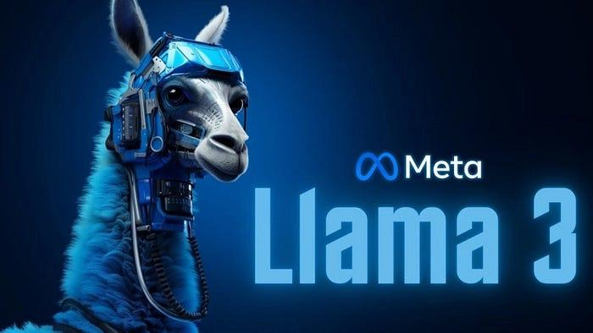
LLM Setup
Ollama Server
Gemma3 LLM
Llama3.2 LLM
Ollama allows LLM models to run locally.
This was set up on the same machine running the notebook.
Ollama allows for an API query to be sent in order to fulfil the assignment’s requirements.
Google’s Gemma3 LLM was used for the main testing.
Meta’s llama3.2 LLM model was used as a secondary comparison to gemma3’s results.
Notes:
The set up used a Linux machine that ran the Ollama Server which would then be used by the Jupyter notebook when calling an LLM.
Ollama can hold multiple models at the same type and then “call” the model requested, so Gemma3 & Llama3.2 would be called through this service.

Slide 8
Data Preprocessing
Tables (CSV) used
Data Cleaning
Allergies
Patients
Observations
Immunizations
Renamed duplicate named columns
Filled Nan entries with ‘none’ where applicable
Added “is_allergy” column
Sample Sizes
Combined Tables
Shot prompts
Sample Size: 25,000 patient entries
Chain-of-thought
Sample Size: 3,000 entries
Using pandas, all tables merged on patient column.
Notes:
We only needed 4 table from the dataset for our purposes
The data needed lots of cleaning when combining the information to prevent columns from getting confused and mixed, and a new column was added to quickly categorize if a patient had an allergy
We had over 2 Million entries in our dataset, but due to the time it takes for the LLM to respond, the dataset was limited to use 25,000 entries for the zero, one, and multi shot prompt categories.
Chain of thought took up significantly more time, so the data here was limited to 3,000 entries. This is smaller than the other categories, but it is still a large enough dataset to be statistically valid since we made sure to randomize the data before being selected.

Slide 9
Steps
Data Shuffling
Query LLM on Multi-shot prompt
Query LLM on Zero-shot prompt
Query LLM on Chain-of-thought prompt
Query LLM on One-shot prompt
Evaluate Results
Notes:
The high perspective steps we took are outlined here, and the results will be displayed on the following slides.
All code is available in the references slide.

Slide 10
Shot Query Results
(gemma3)
Zero-Shot:
Samples: 25,000
Correct: 10,904
Accuracy: 43.62%
One-Shot:
Samples: 25,000
Correct: 10,909
Accuracy: 43.64%
Multi-Shot:
Samples: 25,000
Correct: 14,115
Accuracy: 56.46%

Slide 11
Shot Query Results
(llam3.2)
Zero-Shot:
Samples: 25,000
Correct: 10,893
Accuracy: 43.57%
One-Shot:
Samples: 25,000
Correct: 10,893
Accuracy: 43.57%
Multi-Shot:
Samples: 25,000
Correct: 10,900
Accuracy: 43.60%

Slide 12
Chain-of-thought Query Results
gemma3:
Samples: 3000
Correct: 1,310
Accuracy: 43.67%
Unable to determine: 3
llama3.2:
Samples: 3,000
Correct: 1,316
Accuracy: 43.87%
gemma3 (multi-shot chain):
Samples: 3000
Correct: 1,557
Accuracy: 51.90%

Slide 13
Shot Prompt
1st attempt (Gemma3):
One-Shot learning gave a 0.025 improvement over Zero-Shot.
2nd attempt (llama3.2):
Zero-Shot and One-Shot learning made no difference.
It appears these 2 models were not affected by a One-Shot learning prompt. They both gave identical scores which were worse than a coin flip guess.
Multi-Shot learning made a slight improvement on llama3.2.
Multi-Shot learning made a significant improvement on Gemma3 (12.82% improvement)
Evaluation
Notes:
On Gemma3 the slight improvement seems to indicate that (at least for the models used), one shot learning does not make too much of a difference.
This can be valid given that gemma3 & llama3.2 are significantly larger models with more parameters, so they naturally act as connoisseurs when responding.
Multi shot learning did make a significant improvement on the gemma3 model, but not on the llama3.2 model.
Exact reason for the lack of improvement on llama3.2 were not fully explored as the Gemma3 model was main model we were focused on.
We’ll explain why llama3.2 was used at all in the chain prompt evaluation.

Slide 14
Chain Prompt
Chain prompting made very small improvements.
Only slightly better than One shot prompting when Chain prompting used a zero shot prompt base.
Multi-shot Chain prompt.
8% improvement
Evaluation
Notes:
Chain prompting turned out surprisingly low improvements.
These results led to trying a 2nd LLM model for comparison (llama3.2)
When both models yielded the same small improvements, a new method was introduced to increase the score.
We used a multi-shot chain prompt that included each prompt in the chain with a multi-shot prompt base and that significantly increase the model’s accuracy.
Over all chain prompting still yielded lower accuracy than multi-shot prompting indicating that the quality of the chain prompts can still be improved and the model with some refined prompt engineering can result in higher accuracy.
As a side note, some of the results were lost during testing through accidental deletion of files, but the Gemma3 model was able at one point to achieve 61% accuracy when using a zero-shot chain prompt. This was dependent on training set, but does indicate there is huge room for improvement if a larger set and prompting is refined.

Slide 15

Thank You

Slide 16
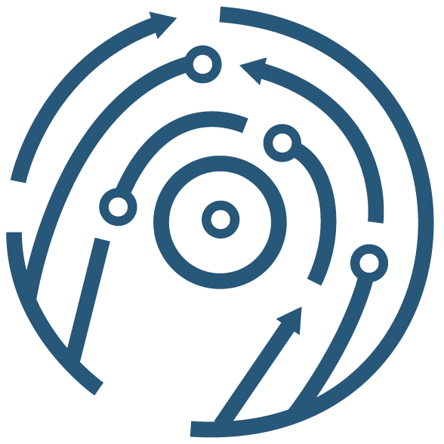




References
Synthea Sample Data
Ollama
Gemma3
Llama 3.2
Source Code
https://synthea.mitre.org/downloads
Simulated patient data
https://ollama.com
LLM loader tool
https://ollama.com/library/gemma3
Google’s open LLM Model
https://ollama.com/library/llama3.2
Meta’s open LLM Model
https://github.com/CountDer3k/Homework-AIH-2025/tree/main/HW6
My Github

